Slide 1
JWT
CHAPTER 11 · BOOKS API
JWT Authentication
in Books REST API
Slim Framework · Firebase JWT · PHP 8

Slide 2
What is JWT?
JSON Web Token — a compact, self-contained way to transmit trusted information
HEADER
PAYLOAD
SIGNATURE
.
.
{
"alg": "HS256",
"typ": "JWT"
}
{
"iss": "books-api",
"sub": 3,
"role": "admin",
"iat": 1700000000,
"exp": 1700003600
}
HMAC-SHA256(
base64(header) +
"." +
base64(payload),
SECRET
)
Algorithm & token type
Claims — user data
Integrity proof
eyJhbGciOiJIUzI1NiIsInR5cCI6IkpXVCJ9 . eyJpc3MiOiJib29rcy1hcGkiLCJzdWIiOjMsInJvbGUiOiJhZG1pbiJ9 . SflKxwRJSMeKKF2QT4fwpM

Slide 3
JWT Configuration — JwtService.php
namespace App\Auth;
use Firebase\JWT\JWT;
use Firebase\JWT\Key;
final class JwtService {
private string $secret;
private string $algo = 'HS256';
private int $ttl;
private string $issuer;
public function __construct() {
$this->secret = $_ENV['JWT_SECRET'];
$this->ttl = (int)($_ENV['JWT_TTL'] ?? 3600);
$this->issuer = $_ENV['JWT_ISSUER'] ?? 'books-api';
}
}
🔑 JWT_SECRET
Your signing key
Never committed to Git
⏱ JWT_TTL
3600 (1 hour)
Token lifetime in seconds
🏷 JWT_ISSUER
"books-api"
Identifies the token creator
🔐 Algorithm
HS256 (HMAC-SHA256)
Symmetric — one shared secret

Slide 4
Step 1 — Token Issuance (Login)
Client
POST /auth/login
AuthController
JwtService::issue()
JWT Token
JWT Payload Claims
JWT Payload Claims
Response JSON
iss
"books-api"
Issuer — who created the token
{
"token_type": "Bearer",
"expires_in": 3600,
"access_token": "eyJhbGci..."
}
sub
3
Subject — user ID
iat
1700000000
Issued-At timestamp
exp
1700003600 (+1 hr)
Expiry timestamp
The client stores this token and includes it
in the Authorization header for protected requests.
role
"admin" | "member"
User role (extra claim)
email
"user@example.com"
Email (extra claim)

Slide 5
Step 2 — Client Sends the Token
Authorization:
Bearer
eyJhbGciOiJIUzI1NiIsInR5cCI6IkpXVCJ9.eyJpc3MiOiJib29rcy1hcGkiLCJzdWIiOjMsInJvbGUiOiJhZG1pbiJ9.xxxx
🌐 PUBLIC (No Token Required)
🔒 PROTECTED (Bearer Token)
GET /api/books
POST /api/books
GET /api/books/{id}
PUT /api/books/{id}
POST /auth/register
DELETE /api/books/{id} + admin
POST /auth/login
GET /auth/me

Slide 6
Step 3 — AuthMiddleware Verification
1
Extract token from header
$hdr = $req->getHeaderLine('Authorization');
if (!preg_match('/^Bearer\s+(.+)$/i', $hdr, $m)) {
return $this->fail('Missing or malformed token'); // 401
}
2
Verify signature & expiry
try {
$payload = $this->jwt->verify($m[1]);
} catch (\Throwable $e) {
return $this->fail('Invalid or expired token'); // 401
}
3
Attach payload to request
$req = $req->withAttribute('auth', $payload);
return $h->handle($req); // pass to controller
⚠ Invalid / expired token → 401 Unauthorized + WWW-Authenticate: Bearer header returned

Slide 7
Step 4 — Using the Payload in Controllers
No extra database call needed — identity lives inside the token
BookController::delete() — Admin role check
$auth = (array)$req->getAttribute('auth', []);
if (($auth['role'] ?? 'member') !== 'admin') {
return $this->json($res, ['error' => 'Admins only'], 403); // Forbidden
}
AuthController::me() — Fetch profile from token sub
$auth = (array)$req->getAttribute('auth', []);
$u = $this->users->findById((int)($auth['sub'] ?? 0));
return $u ? $this->json($res, $u) : $this->json($res, ['error' => 'Not found'], 404);

Slide 8
Protected vs Public Routes
Route | Method | Auth Required | Extra Condition
/api/books | GET | No | —
/api/books/{id} | GET | No | —
/auth/register | POST | No | —
/auth/login | POST | No | —
/api/books | POST | Bearer | —
/api/books/{id} | PUT | Bearer | —
/api/books/{id} | DELETE | Bearer | role = admin
/auth/me | GET | Bearer | —

Slide 9
Key Design Decisions
🔐 HS256 — Symmetric signing
One shared secret for both signing and verification. Ideal for a single-server API where key distribution complexity is unnecessary.
⚡ Stateless architecture
No session table or server-side storage needed. Any request can be validated purely from the token — scales horizontally.
⚙ TTL configured via .env
Token lifetime adjustable per environment (dev/staging/prod) without touching source code. Default: 3600 s.
🔗 withAttribute('auth', payload)
Slim's clean pattern for passing verified data downstream. No global state, no superglobals, fully testable.
👤 Role stored inside the token
admin vs member enforced in controllers from the payload. Zero extra database calls per request for authorization.

Slide 10
Complete JWT Flow
Client
(Browser / Vue)
POST /auth/login
{email, password}
AuthController
+ UserRepository
JwtService
::issue()
JWT Token
returned
Protected Request Flow
Client
sends Bearer
AuthMiddleware
jwt->verify()
payload →
withAttribute
BookController
or AuthController
MySQL
(PDO)
Invalid token → 401

Slide 11
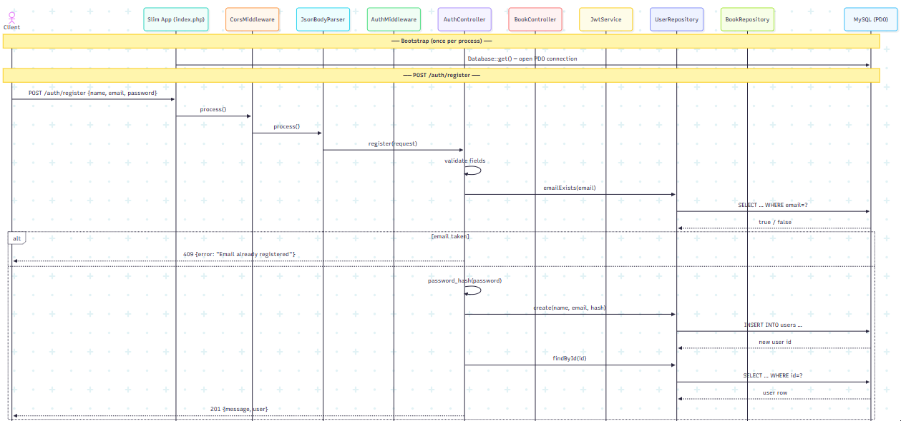
POST /auth/register

Slide 12
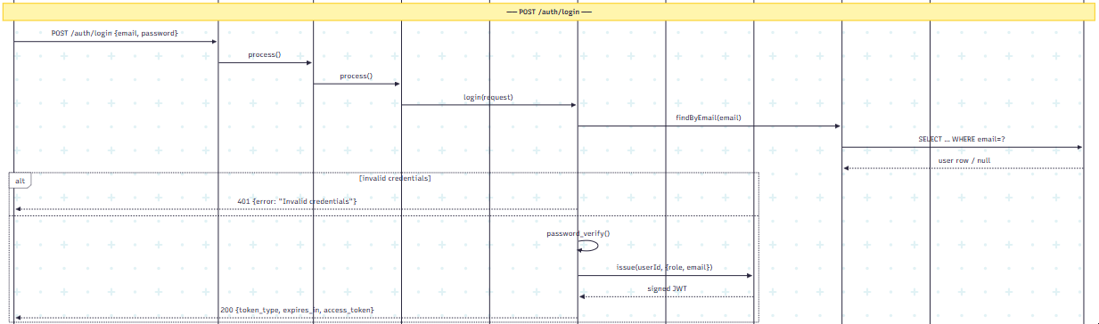
POST /auth/login

Slide 13
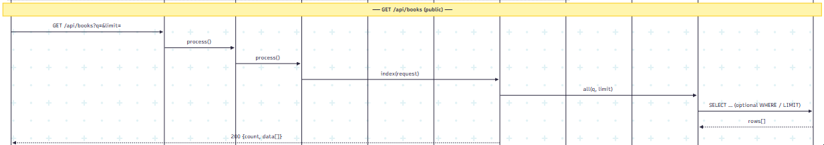
GET /api/books (public)

Slide 14
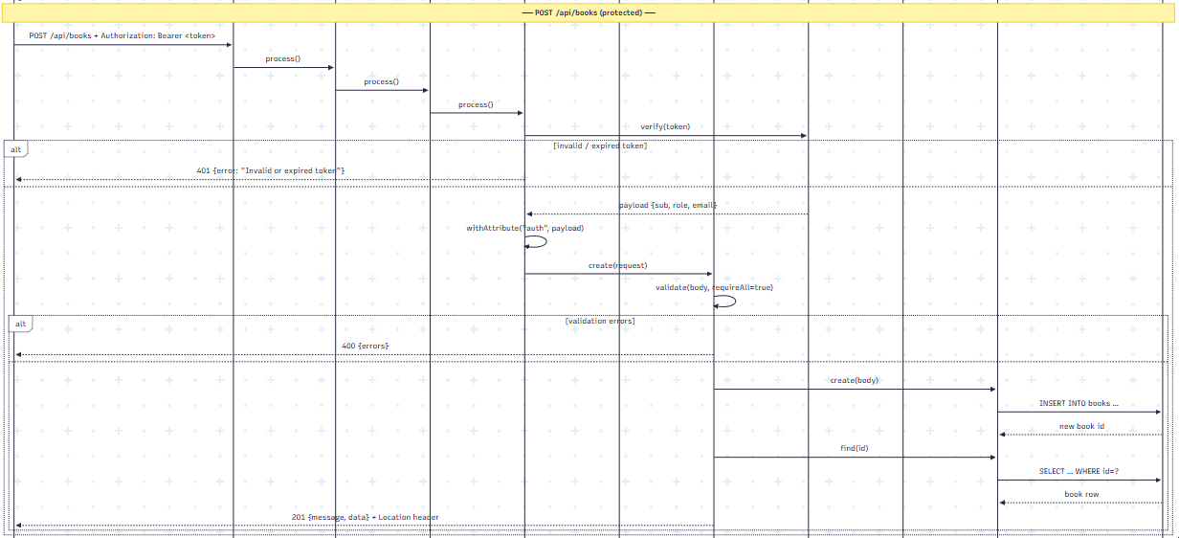
POST /api/books (protected)

Slide 15
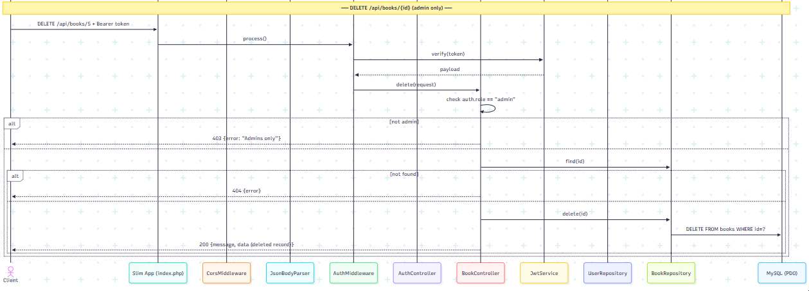
DELETE /api/books/{id} (admin only)

